Slide 1
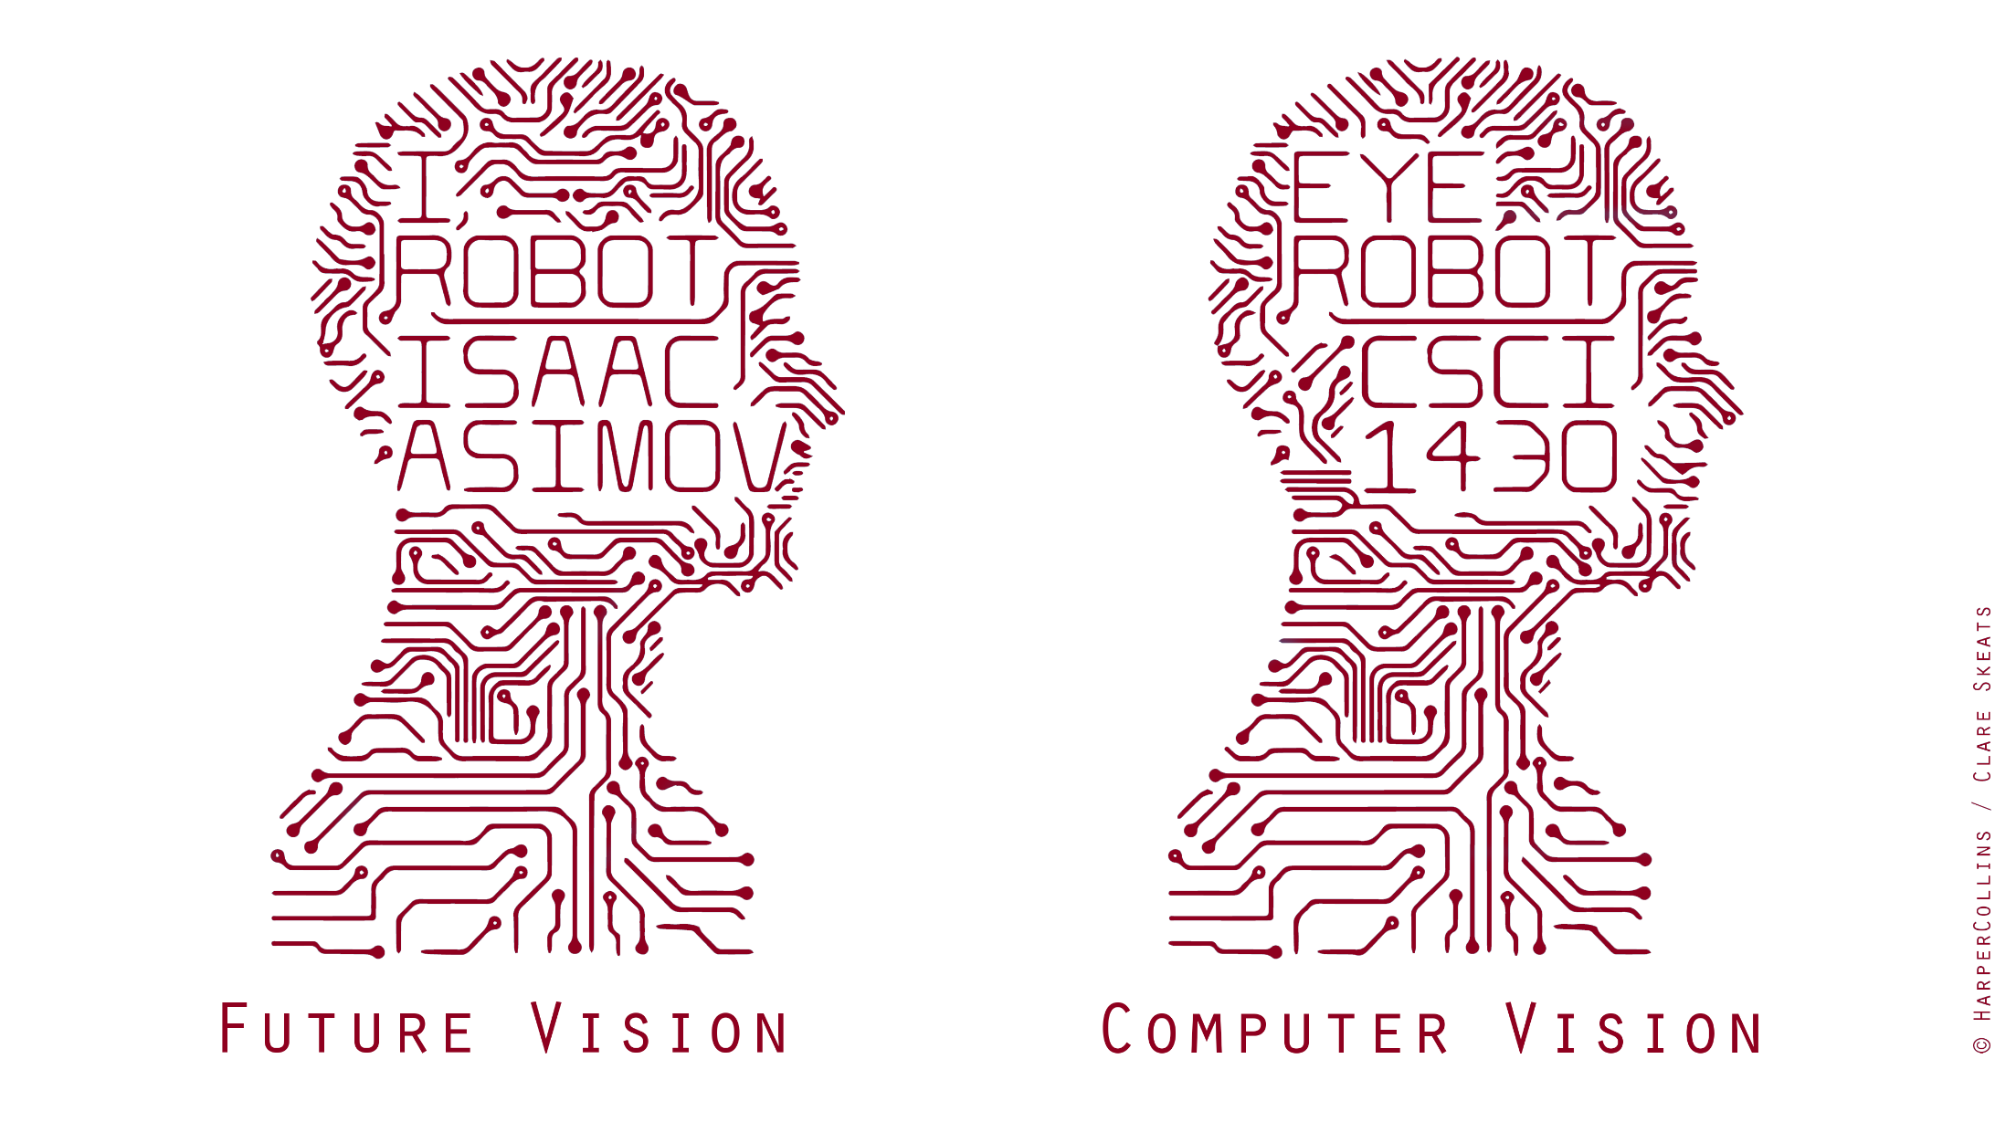
Prismia.Chat https://tinyurl.com/y26ragof
Notes:
https://tinyurl.com/y26ragof
https://prismia.chat/projects/ccaebf77-a313-4f85-a7ee-4416aaaf014d/join
Hello everyone – welcome to CSCI 1430 computer vision!
In the 1950s, visionary writer Isaac Asimov imagined a future where robots could interact naturally within a human world.
Core to this idea is the capability of robots – or more generally _computers_ - to perceive the natural world and extract information from it.
To move within it, to recognize and classify, and to make decisions upon that information and act.
This idea is compelling – and - vision comes so easily to most humans that it can’t be _that_ difficult to program a computer to see.
So it is that, in 1966, an unlucky intern at MIT’s AI lab was assigned ‘computer vision’ as a summer project.
It turned out not to be so easy – for 50 years, academics struggled to make practical eye robots. Yet, in the past 5 years, we have seen significant progress and computer vision systems are now functional and deployable en masse – sometimes for better, and sometimes for worse.
So – hello – I’m James Tompkin – I’m an assistant professor in the computer science department.
And, over the next three months, it will be my pleasure to teach you all about this exciting topic, and for you to become ‘visionaries’ too in the process.
With me in this endeavour is my co-instructor Srinath Sridhar – over to Srinath.

Slide 2
What is
computer vision?

Slide 3
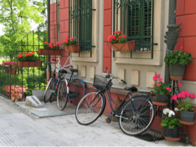
What a person sees

Slide 4
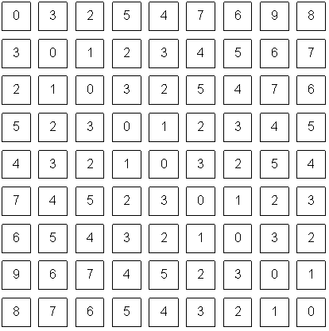
What a computer sees

Slide 5
Why are we able to interpret this image?

Slide 6
The goal of computer vision is
to give computers (super) human-level perception

Slide 7

typical perception pipeline
representation
‘fancy math’
output

Slide 8
typical perception pipeline
representation
what should we look at?
(image features)
‘fancy math’
output
what can we understand?
(semantic segmentation)

Slide 9

typical perception pipeline
representation
what should we look at?
(image features)
easy to get lost in the techniques
‘fancy math’
output
what can we understand?
(semantic segmentation)

Slide 10


typical perception pipeline
representation
what should we look at?
(image features)
The parts that we are most interested in
‘fancy math’
output
what can we understand?
(semantic segmentation)

Slide 11
Important note:
In general, computer vision does not work
(except in certain cases)

Slide 12
Important note:
In general, computer vision does not work
(except in certain situations/conditions)

Slide 13
Applications of computer vision

Slide 14
Laptop: Biometrics auto-login (face recognition, 3D), OCR
Smartphones: QR codes, computational photography (Android Lens Blur, iPhone Portrait Mode), panorama construction (Google Photo Spheres), face detection, expression detection (smile), Snapchat filters (face tracking), FaceID (iPhone), Night Sight (Pixel), iPhone 12 Pro (LiDAR)
Web: Image search, Google photos (face recognition, object recognition, scene recognition, geolocalization from vision), Facebook (image captioning), Google maps aerial imaging (image stitching), YouTube (content categorization)
VR/AR: Outside-in tracking (HTC VIVE), inside out tracking (simultaneous localization and mapping, HoloLens), object occlusion (dense depth estimation)
Motion: Kinect, full body tracking of skeleton, gesture recognition, virtual try-on
Medical imaging: CAT / MRI reconstruction, assisted diagnosis, automatic pathology, connectomics, endoscopic surgery
Industry: Vision-based robotics (marker-based), machine-assisted router (jig), automated post, ANPR (number plates), surveillance, drones, shopping
Transportation: Assisted driving (everything), face tracking/iris dilation for drunkeness, drowsiness, automated distribution (all modes)
Media: Visual effects for film, TV (reconstruction), virtual sports replay (reconstruction), semantics-based auto edits (reconstruction, recognition)
Notes:
James made a 10-minute list of all the existing applications that he could think of which used computer vision.

Slide 15


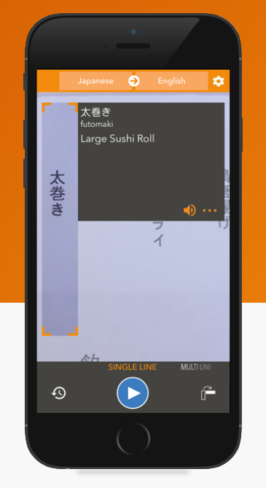
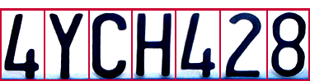
Optical character recognition (OCR)
Technology to convert images of text into text
If you have a scanner, it probably came with OCR software
Live Camera Translation
Mail digit recognition, AT&T labs
http://www.research.att.com/~yann/
License plate readers
http://en.wikipedia.org/wiki/Automatic_number_plate_recognition
JH
Notes:
If you see a little ‘JH’ in the corner of the slides, then it means it was taken piecemeal from James Hays’ old class. Thank you to him and his course staff, over many years.

Slide 16
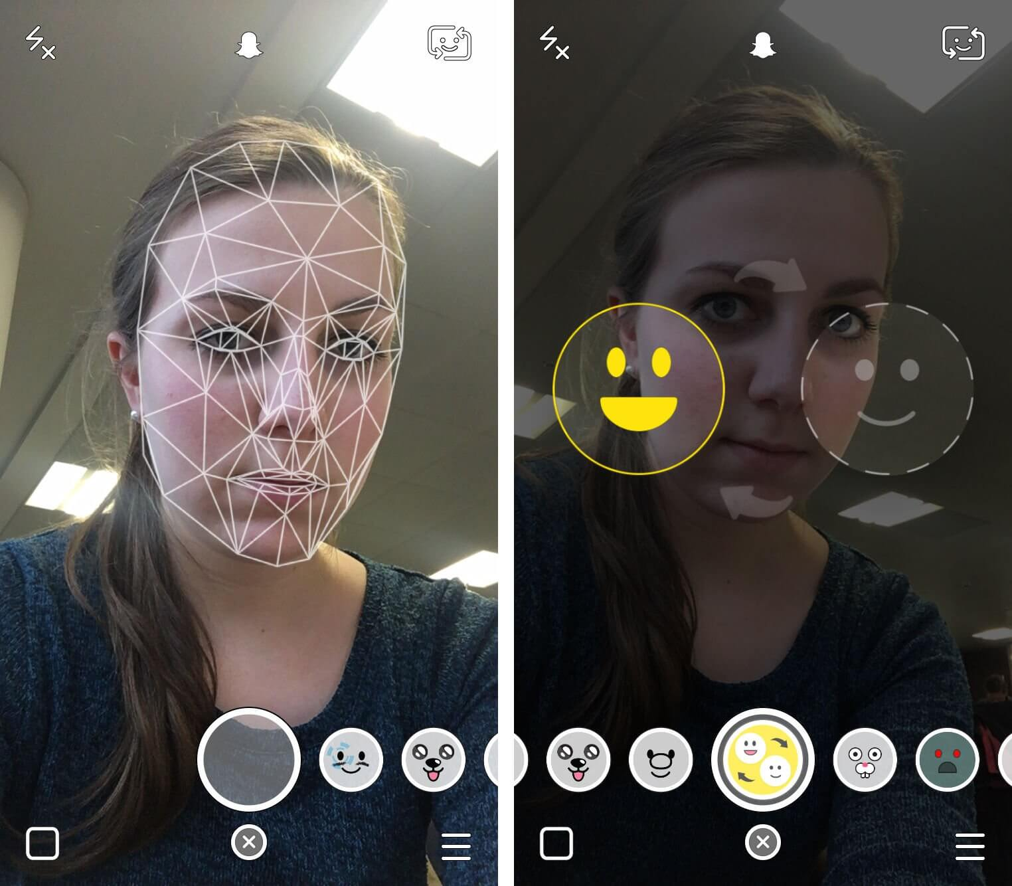
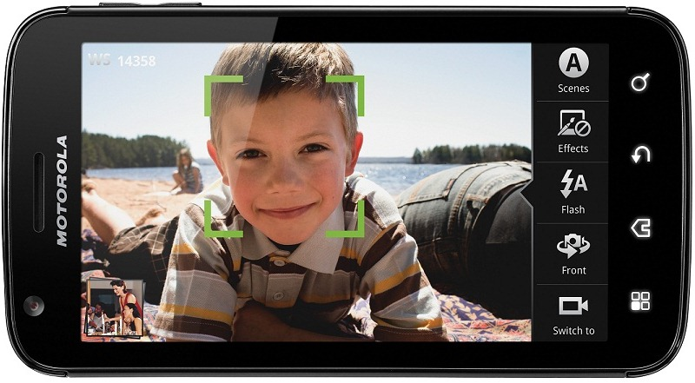
Face detection
Almost all digital cameras detect faces
Snapchat face filters
Notes:
https://www.google.com/url?sa=i&rct=j&q=&esrc=s&source=images&cd=&cad=rja&uact=8&ved=0ahUKEwjPu6nd1N3RAhVK7iYKHWSoDyAQjRwIBw&url=http%3A%2F%2Fforum.xda-developers.com%2Fshowthread.php%3Ft%3D1469709&bvm=bv.145063293,d.eWE&psig=AFQjCNEE8xqcq-R_KwPK2wc0Myo9pkI5Sg&ust=1485446226449425
Why would this be useful? Main reason is focus. Also enables “smart” cropping.

Slide 17
Smile detection
Sony Cyber-shot® T70 Digital Still Camera
JH

Slide 18
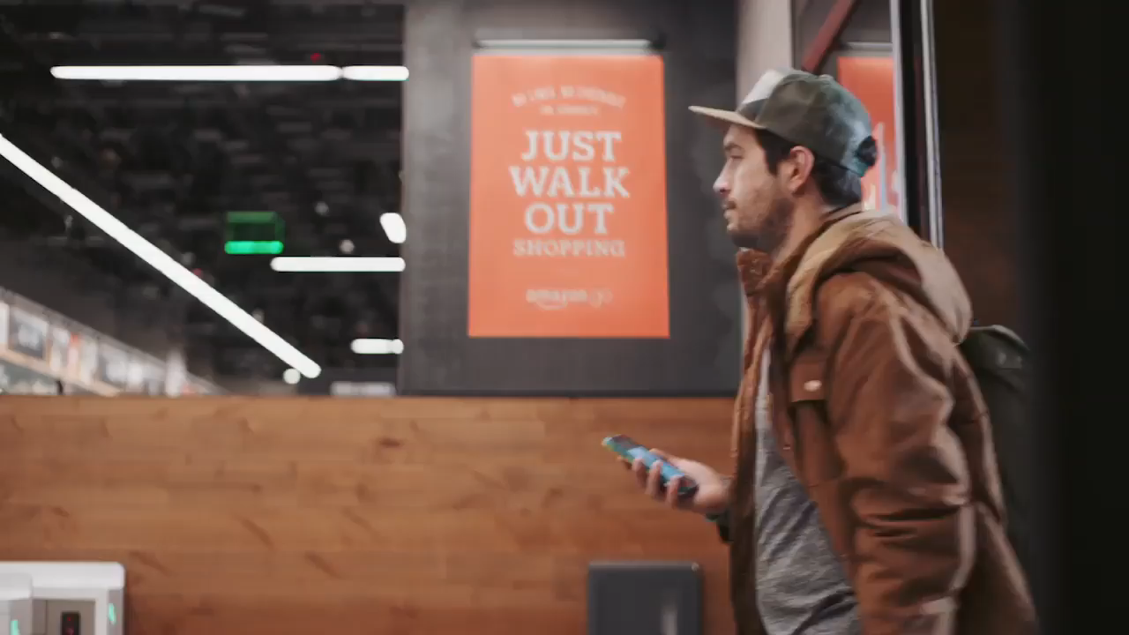
Object recognition (in supermarkets)
Notes:
Amazon Go! https://www.amazon.com/b?ie=UTF8&node=16008589011
Ask – so how does it work?
Think Pair Share!!!

Slide 19
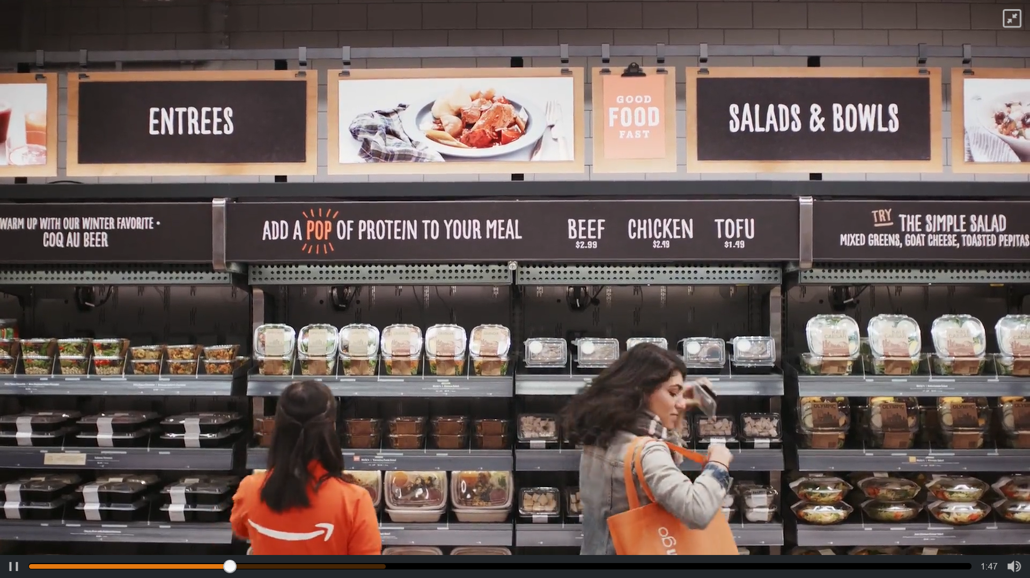
How does it work? Think-Pair-Share Chat

Slide 20

How does it work?
Notes:
Some stores are now open and in trials.

Slide 21
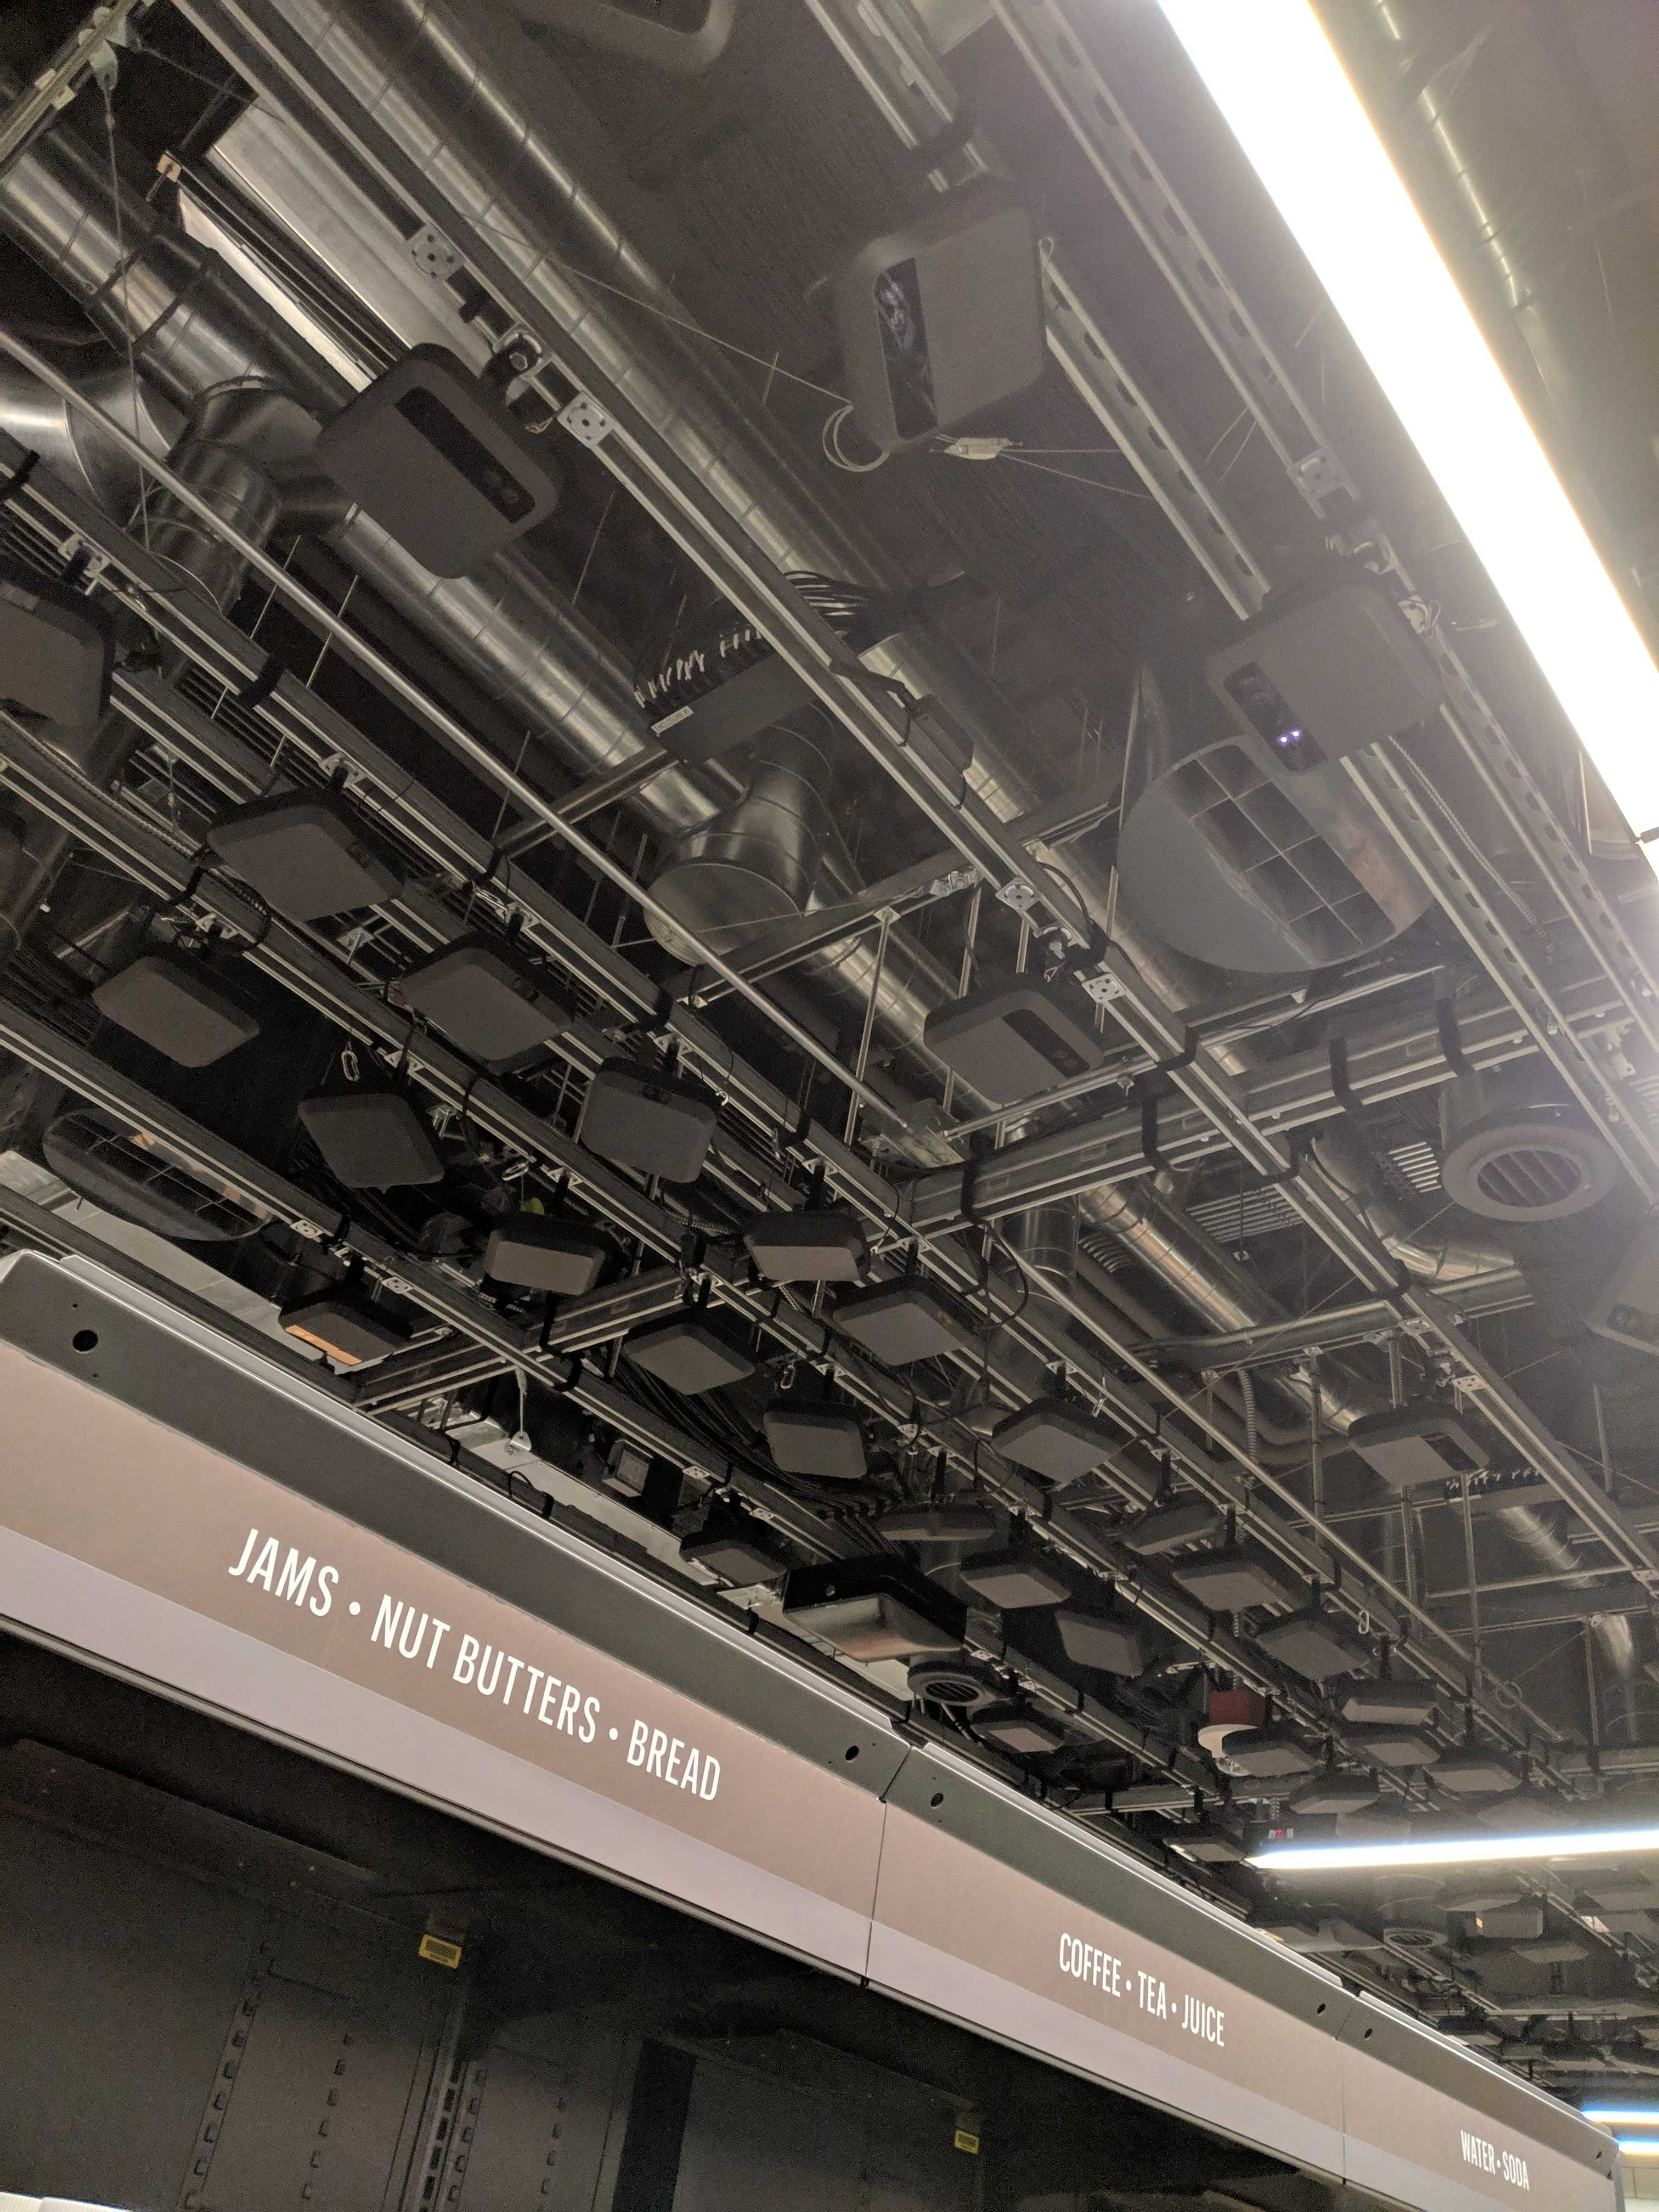
Thanks to Vivek Ramanujan

Slide 22
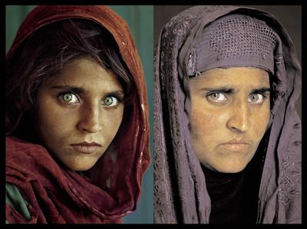
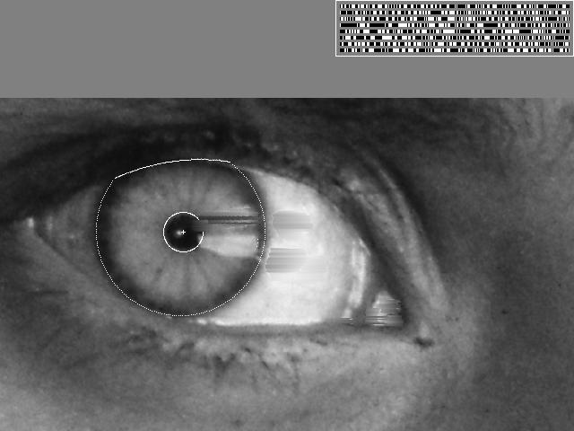
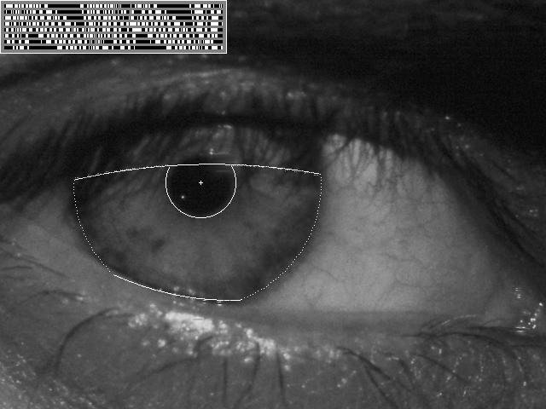
Vision-based biometrics
“How the Afghan Girl was Identified by Her Iris Patterns” Read the story (Wikipedia)
JH
Notes:
National geographic
Age 12, Age 30

Slide 23
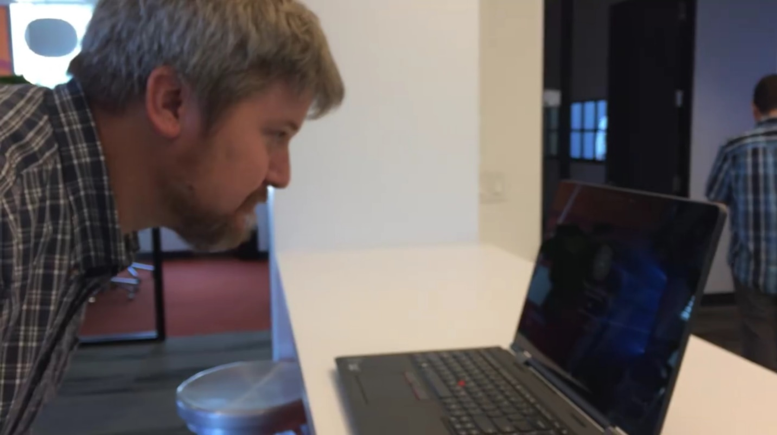
Facial login without a password…
Notes:
https://www.google.com/url?sa=i&rct=j&q=&esrc=s&source=images&cd=&cad=rja&uact=8&ved=0ahUKEwiJmrLm1d3RAhUJ4yYKHYhOBHkQjRwIBw&url=http%3A%2F%2Fwww.pcworld.com%2Farticle%2F2953512%2Fwindows%2Fhands-on-with-windows-10s-windows-hello-it-just-works.html&bvm=bv.145063293,d.eWE&psig=AFQjCNHypmDl0y-viWICMOJODxtwmz34Bg&ust=1485446513829330
https://www.google.com/url?sa=i&rct=j&q=&esrc=s&source=images&cd=&cad=rja&uact=8&ved=0ahUKEwiDkbnw1d3RAhUB3iYKHXs3DnsQjRwIBw&url=http%3A%2F%2Fwww.pcworld.com%2Farticle%2F2937701%2Fwhy-most-of-us-will-miss-out-on-windows-hello-windows-10s-facial-recognition-feature.html&bvm=bv.145063293,d.eWE&psig=AFQjCNHypmDl0y-viWICMOJODxtwmz34Bg&ust=1485446513829330
https://www.google.com/url?sa=i&rct=j&q=&esrc=s&source=images&cd=&cad=rja&uact=8&ved=0ahUKEwjD0LuA1t3RAhUKRSYKHVTSAgwQjRwIBw&url=http%3A%2F%2Fwww.directtechnologygroup.com%2Fblog%2Fentry%2Ftip-of-the-week-windows-hello-unlocks-your-pc-with-your-face&bvm=bv.145063293,d.eWE&psig=AFQjCNHypmDl0y-viWICMOJODxtwmz34Bg&ust=1485446513829330

Slide 24
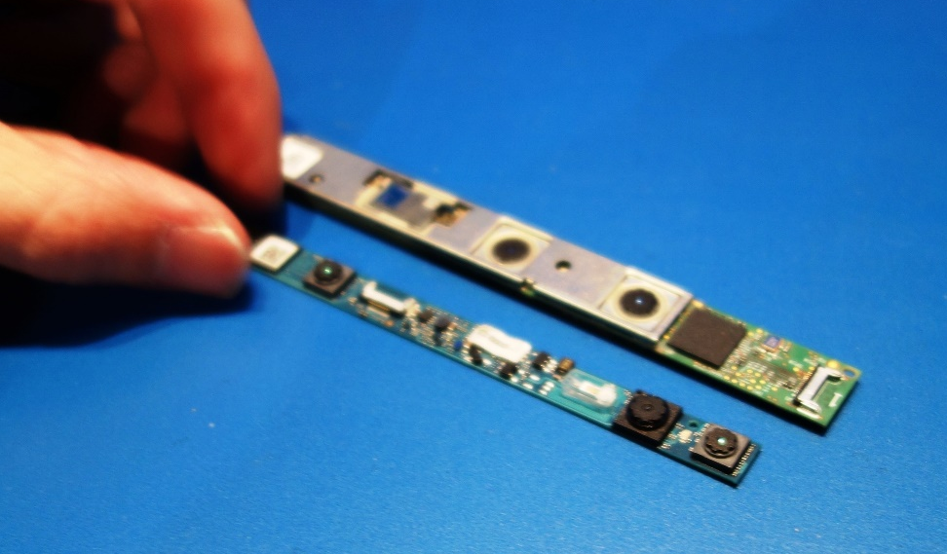
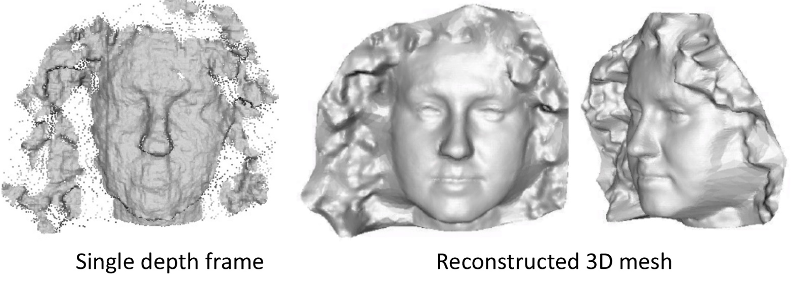
Facial login without a password…
Liang et al. 2014
Notes:
https://www.google.com/url?sa=i&rct=j&q=&esrc=s&source=images&cd=&cad=rja&uact=8&ved=0ahUKEwiJmrLm1d3RAhUJ4yYKHYhOBHkQjRwIBw&url=http%3A%2F%2Fwww.pcworld.com%2Farticle%2F2953512%2Fwindows%2Fhands-on-with-windows-10s-windows-hello-it-just-works.html&bvm=bv.145063293,d.eWE&psig=AFQjCNHypmDl0y-viWICMOJODxtwmz34Bg&ust=1485446513829330
https://www.google.com/url?sa=i&rct=j&q=&esrc=s&source=images&cd=&cad=rja&uact=8&ved=0ahUKEwiDkbnw1d3RAhUB3iYKHXs3DnsQjRwIBw&url=http%3A%2F%2Fwww.pcworld.com%2Farticle%2F2937701%2Fwhy-most-of-us-will-miss-out-on-windows-hello-windows-10s-facial-recognition-feature.html&bvm=bv.145063293,d.eWE&psig=AFQjCNHypmDl0y-viWICMOJODxtwmz34Bg&ust=1485446513829330
https://www.google.com/url?sa=i&rct=j&q=&esrc=s&source=images&cd=&cad=rja&uact=8&ved=0ahUKEwjD0LuA1t3RAhUKRSYKHVTSAgwQjRwIBw&url=http%3A%2F%2Fwww.directtechnologygroup.com%2Fblog%2Fentry%2Ftip-of-the-week-windows-hello-unlocks-your-pc-with-your-face&bvm=bv.145063293,d.eWE&psig=AFQjCNHypmDl0y-viWICMOJODxtwmz34Bg&ust=1485446513829330
http://grail.cs.washington.edu/projects/liangshu/project3Dv.htm
http://grail.cs.washington.edu/projects/liangshu/images/3dv2014/teaser.jpg

Slide 25
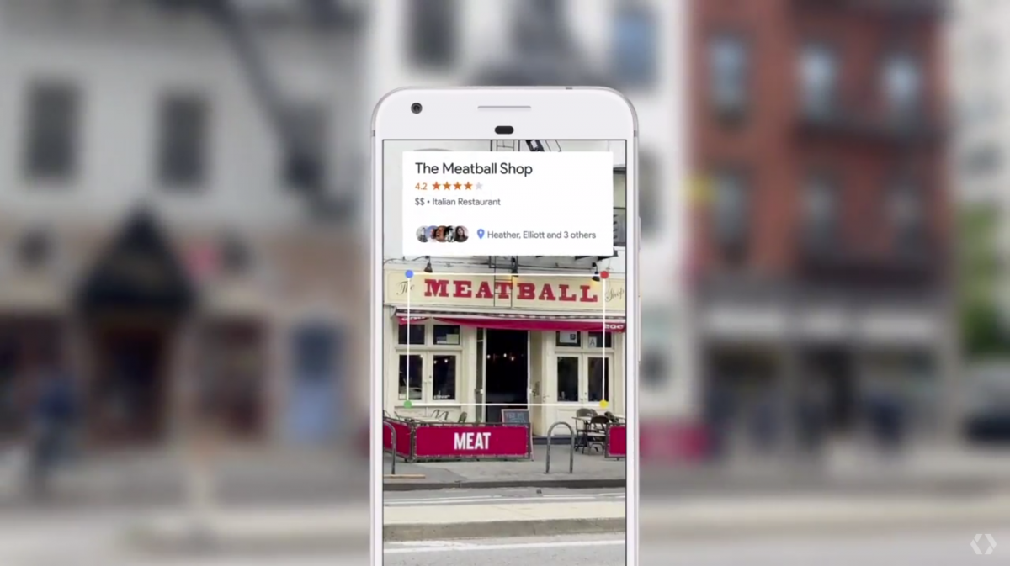
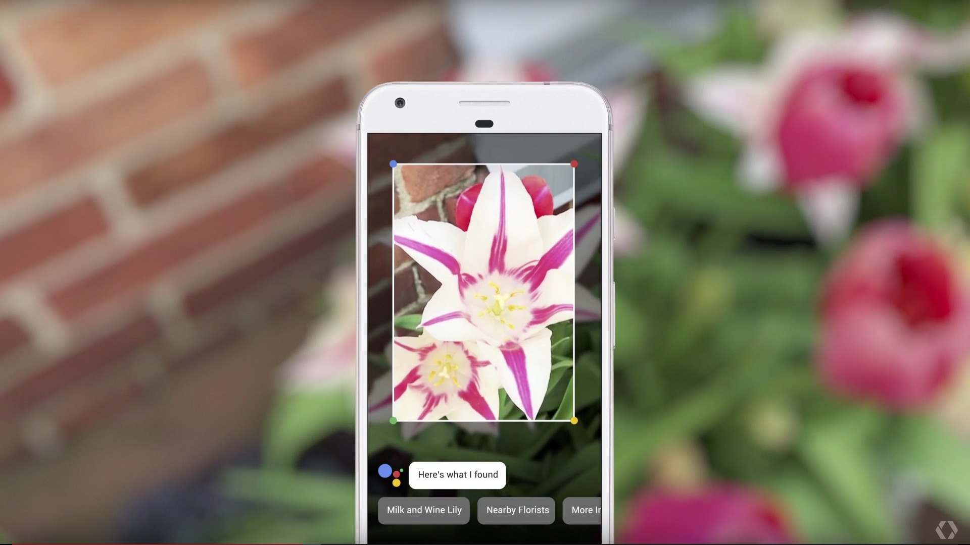
Object recognition (in mobile phones)
e.g., Google Lens
Notes:
Google Lens – introduced at I/O this year.
They didn’t have any ‘wow-factor’ products to show, so they went round the research labs and threw together a bunch of demos they found down the back of the sofa.

Slide 26
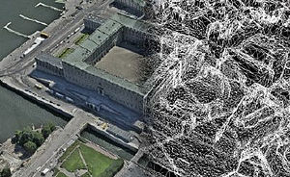
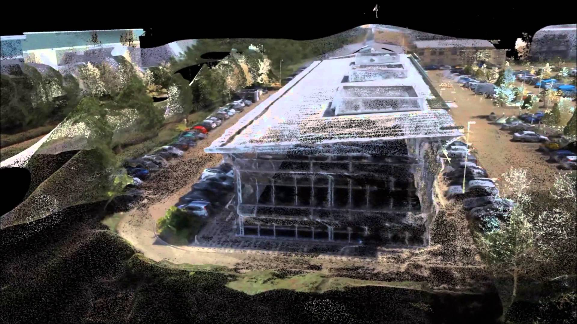
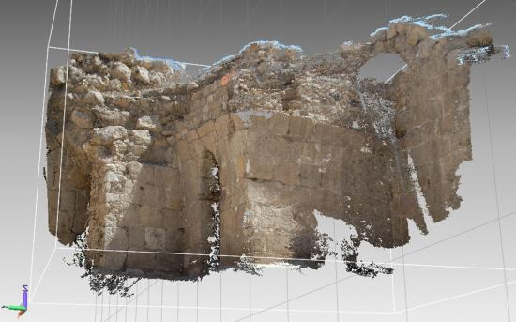
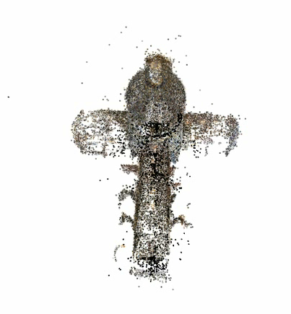
3D from images
Building Rome in a Day: Agarwal et al. 2009
Notes:
https://www.google.com/url?sa=i&rct=j&q=&esrc=s&source=images&cd=&cad=rja&uact=8&ved=0ahUKEwiO3azs1t3RAhVMSyYKHe67Bh8QjRwIBw&url=https%3A%2F%2Fen.wikipedia.org%2Fwiki%2FPhotogrammetry&bvm=bv.145063293,d.eWE&psig=AFQjCNGuhANMLT4cVMPvEM2HZapmFfbS-g&ust=1485446838838556
https://www.google.com/url?sa=i&rct=j&q=&esrc=s&source=images&cd=&cad=rja&uact=8&ved=0ahUKEwjTuuqe193RAhVHwiYKHfSnC-4QjRwIBw&url=http%3A%2F%2Fwww.dicatea.unipr.it%2Fen%2Fresearch%2Fresearch-areas%2Fsurveying-and-photogrammetry&bvm=bv.145063293,d.eWE&psig=AFQjCNGuhANMLT4cVMPvEM2HZapmFfbS-g&ust=1485446838838556
https://www.google.com/url?sa=i&rct=j&q=&esrc=s&source=images&cd=&cad=rja&uact=8&ved=0ahUKEwjryb6s193RAhUCeCYKHWyeDq0QjRwIBw&url=https%3A%2F%2Fwww.youtube.com%2Fwatch%3Fv%3DtSENR_oSEpk&bvm=bv.145063293,d.eWE&psig=AFQjCNGuhANMLT4cVMPvEM2HZapmFfbS-g&ust=1485446838838556

Slide 27
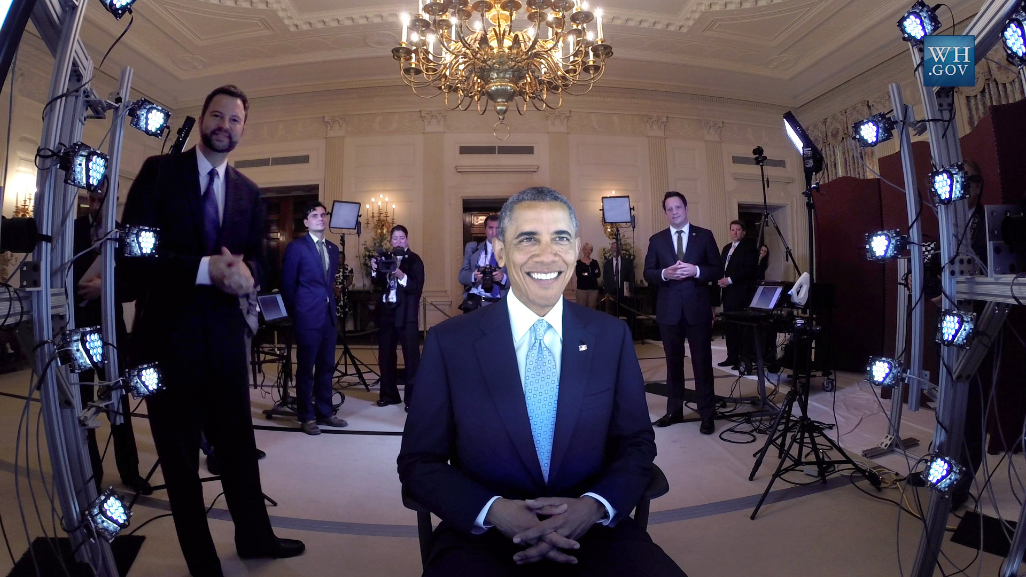
Human shape capture
Notes:
http://gl.ict.usc.edu/Research/presidentialportrait/

Slide 28
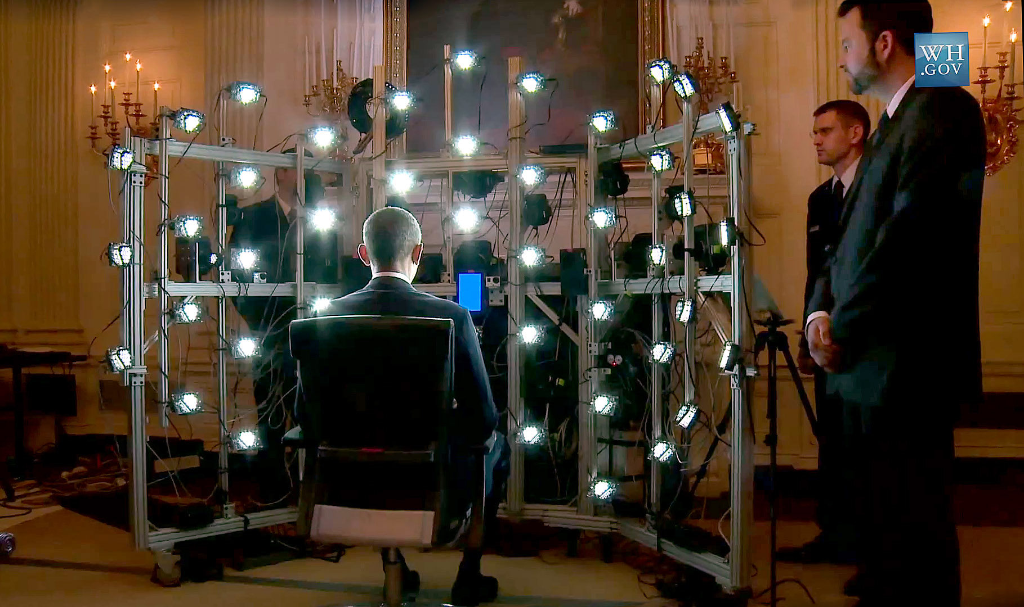
Human shape capture
Notes:
http://gl.ict.usc.edu/Research/presidentialportrait/

Slide 29
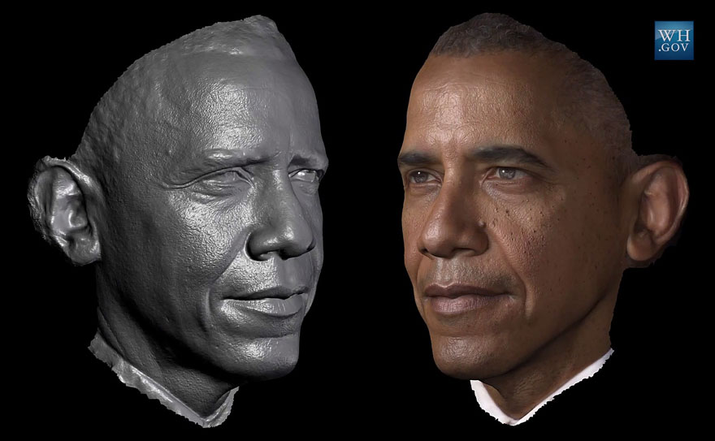
Human shape capture
Notes:
http://gl.ict.usc.edu/Research/presidentialportrait/

Slide 30
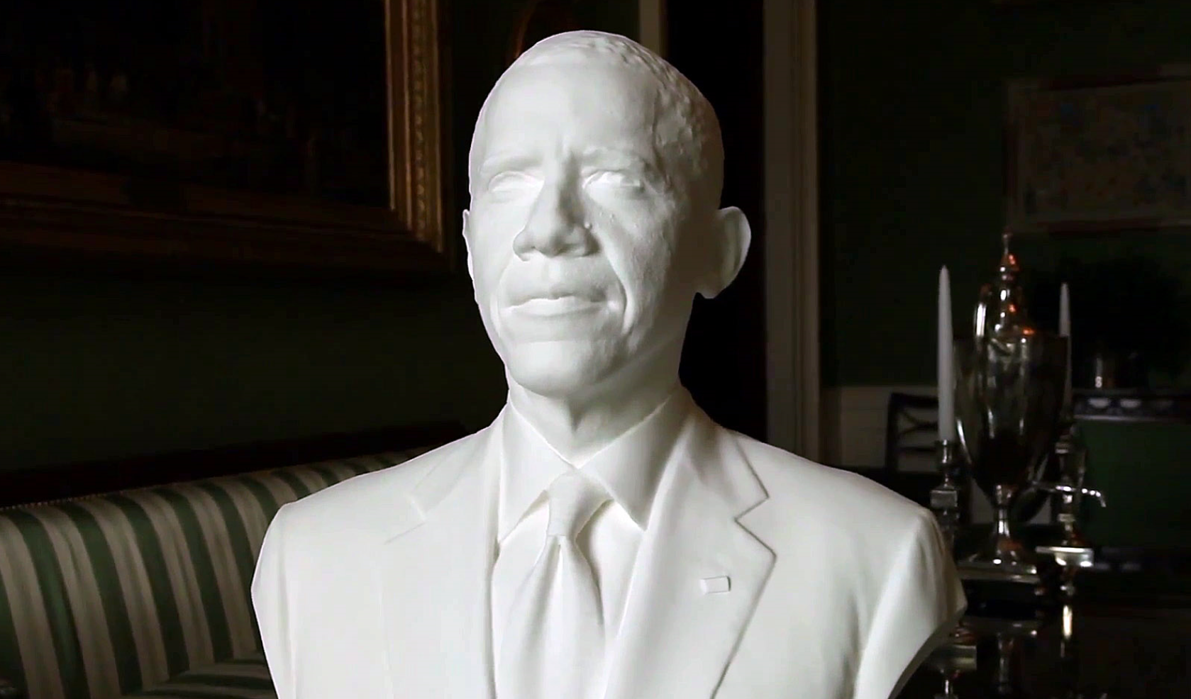
Human shape capture
Notes:
http://gl.ict.usc.edu/Research/presidentialportrait/

Slide 31
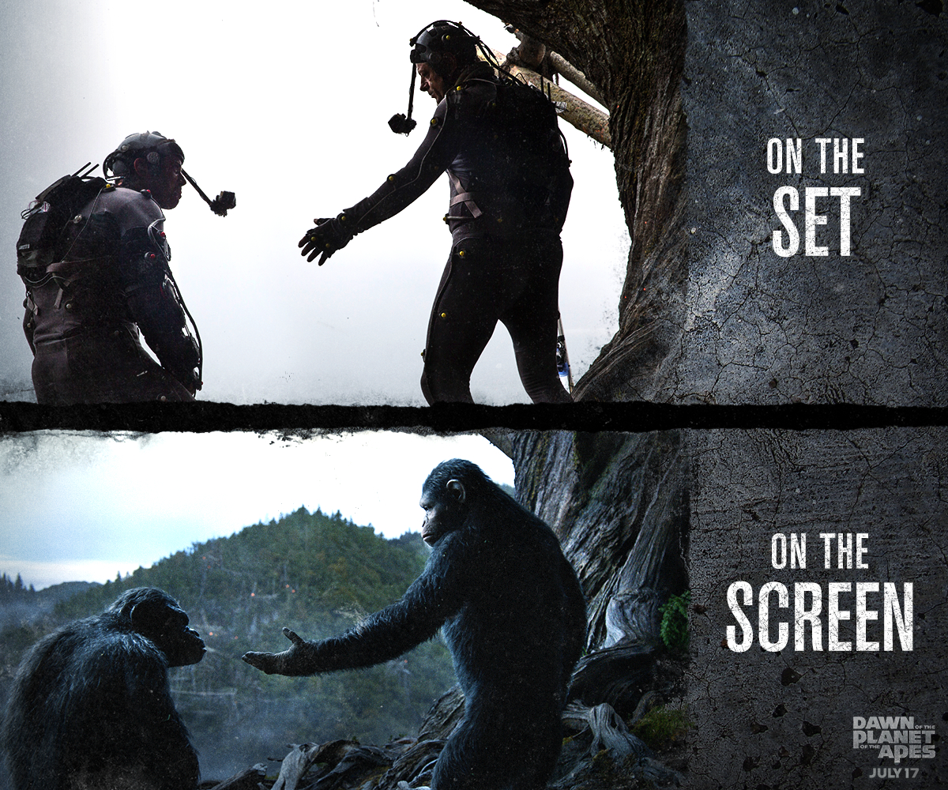
Special effects: motion capture
Notes:
http://www.digitalspy.com/movies/oscars/feature/a584704/why-andy-serkis-deserves-an-oscar-nomination-for-planet-of-the-apes/?zoomable
Weta

Slide 32
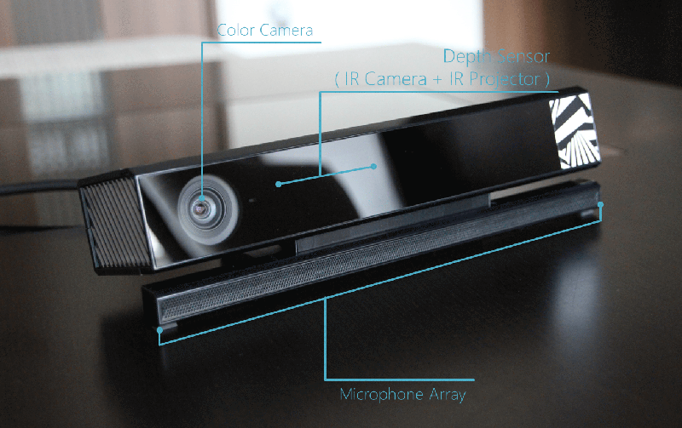
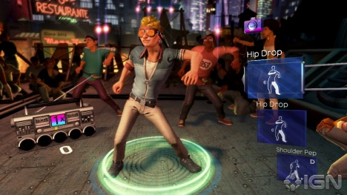
Interactive Games
Object Recognition: http://www.youtube.com/watch?feature=iv&v=fQ59dXOo63o
Mario: http://www.youtube.com/watch?v=8CTJL5lUjHg
3D: http://www.youtube.com/watch?v=7QrnwoO1-8A
Robot: http://www.youtube.com/watch?v=w8BmgtMKFbY
JH

Slide 33
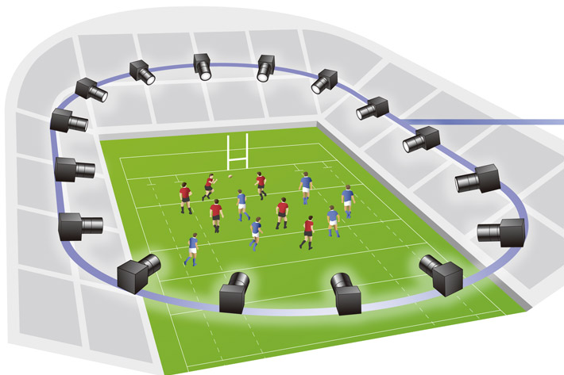
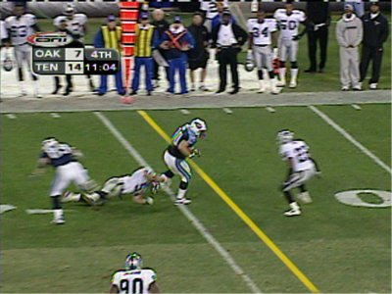

Sports
Virtual pitch markings
Free viewpoint video
Sportvision first down line
Nice explanation on www.howstuffworks.com
[Canon 2017]
JH
Notes:
Canon free-viewpoint video: https://www.youtube.com/watch? v=lqYNgzEqDsM

Slide 34
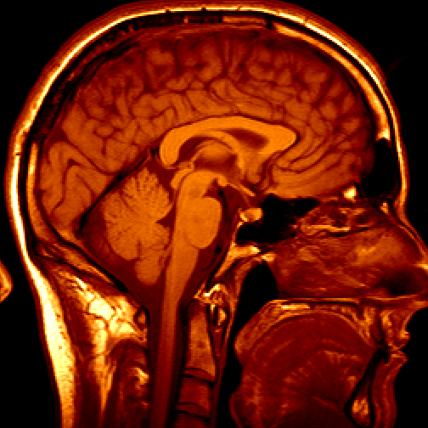
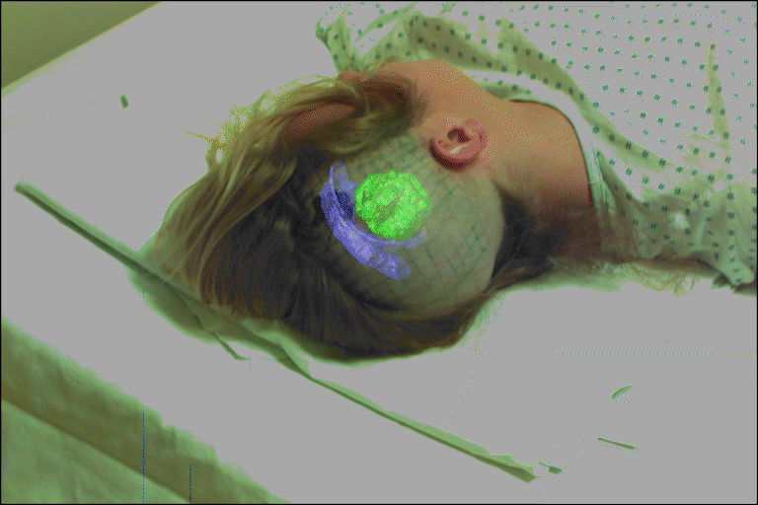
Medical imaging
3D imaging
MRI, CT
Image guided surgery
Grimson et al., MIT
JH

Slide 35
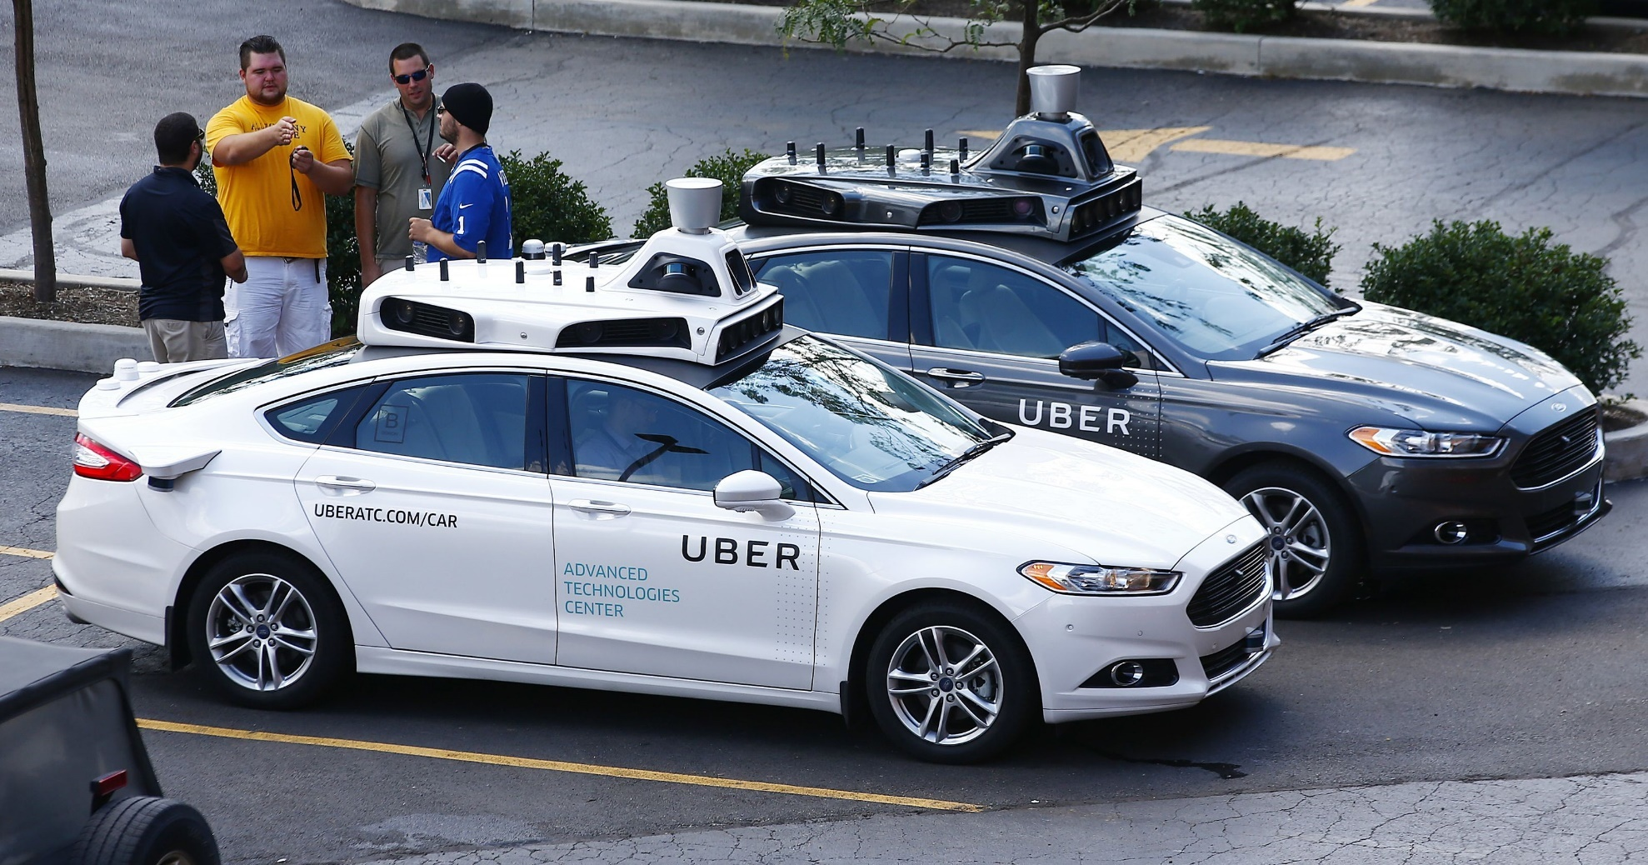
AutoCars - Uber bought CMU’s lab
Notes:
Ask class to count the number of cameras.
http://www.cmu.edu/news/stories/archives/2015/february/uber-partnership.html
http://www.wsj.com/articles/is-uber-a-friend-or-foe-of-carnegie-mellon-in-robotics-1433084582
http://www.freep.com/story/money/cars/ford/2016/08/21/uber--lyft-gm-pittsburgh-autonomous-vehicles-self-driving-autos-equal-profits/88944036/
Oct 9, 2010. "Google Cars Drive Themselves, in Traffic". The New York Times. John Markoff
June 24, 2011. "Nevada state law paves the way for driverless cars". Financial Post. Christine Dobby
Aug 9, 2011, "Human error blamed after Google's driverless car sparks five-vehicle crash". The Star (Toronto)

Slide 36
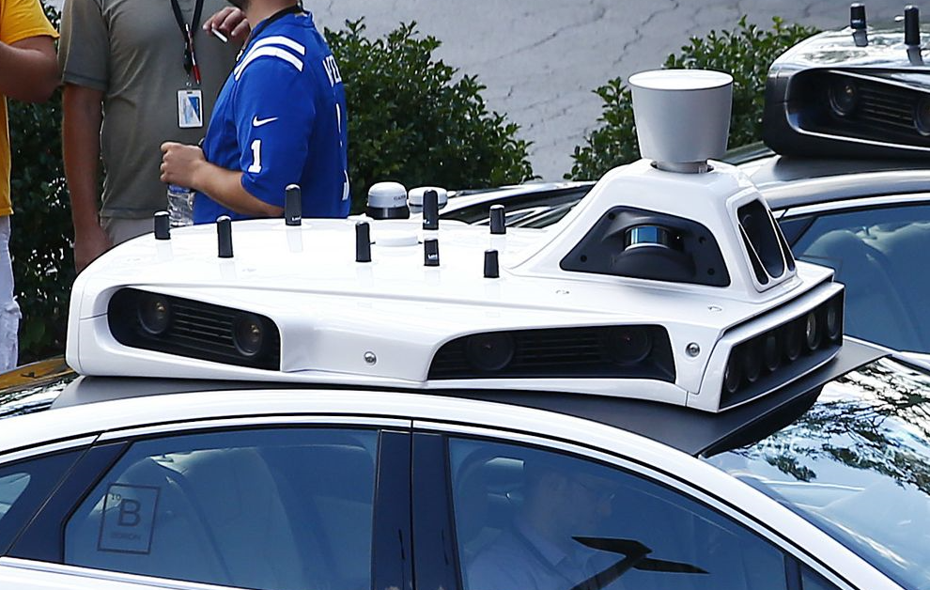
Notes:
Ask class to count the number of cameras.

Slide 37
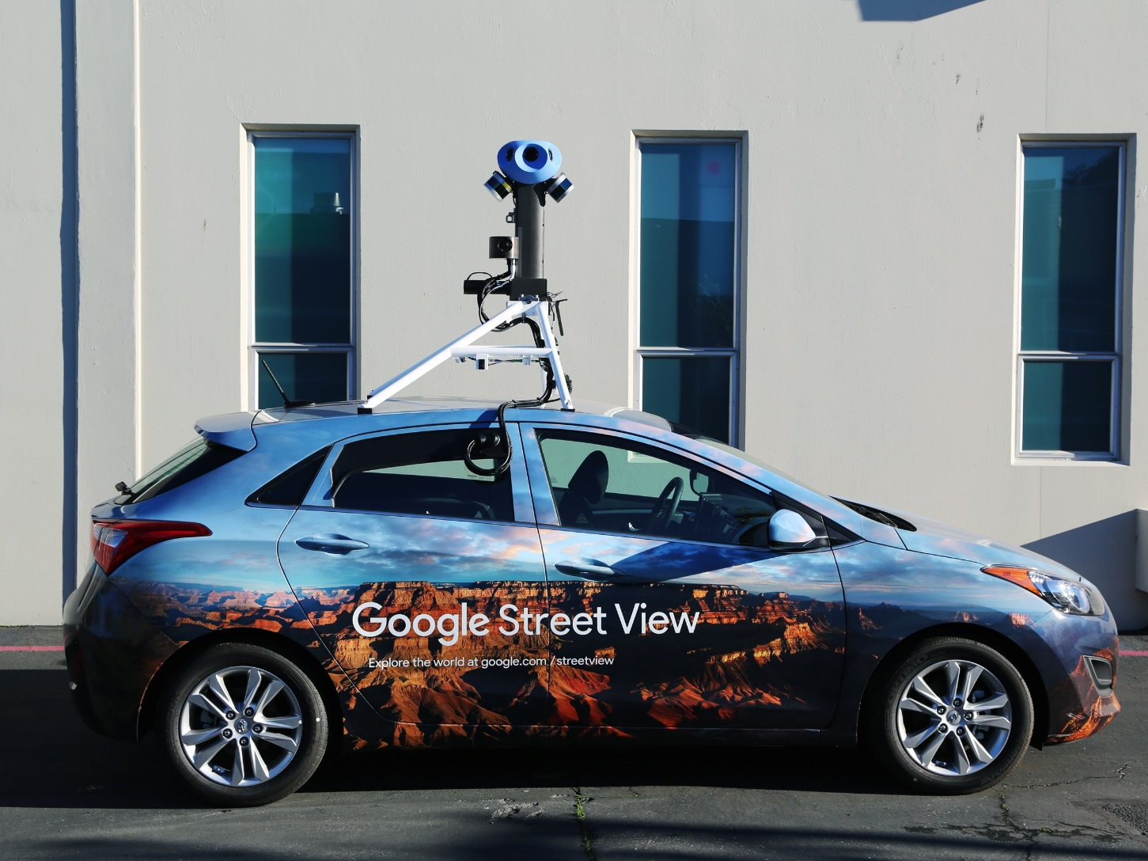

Slide 38
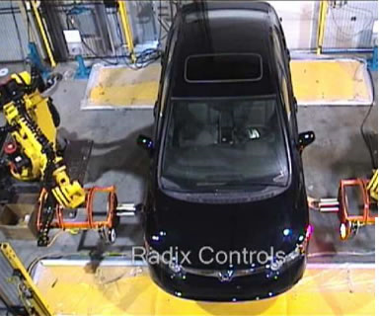
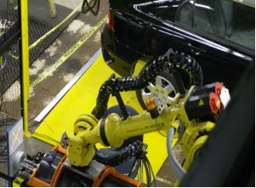
Industrial robots
Vision-guided robots position nut runners on wheels
JH

Slide 39

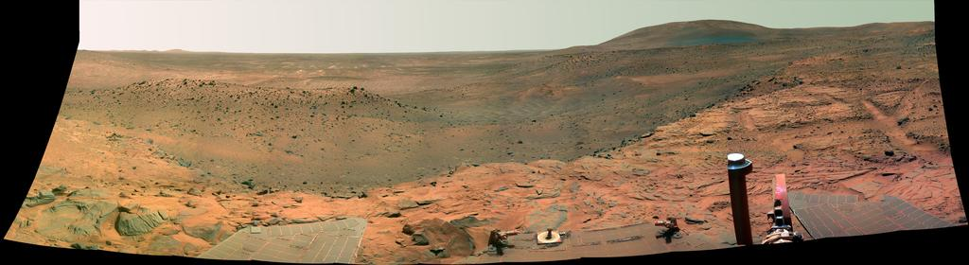
Vision in spaaaaace
NASA'S Mars Exploration Rover Spirit captured this westward view from atop a low plateau where Spirit spent the closing months of 2007.
Vision systems (JPL) used for several tasks
Panorama stitching
3D terrain modeling
Obstacle detection, position tracking
For more, read “Computer Vision on Mars” by Matthies et al.
JH

Slide 40
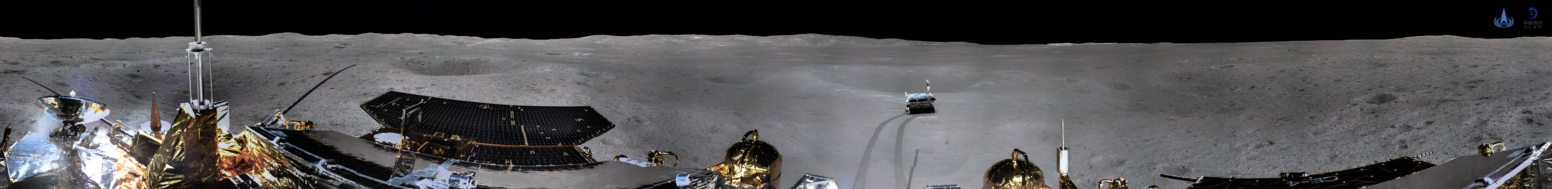

2019 Chang-e 4
Moon Lander
Notes:
Named after the Chinese goddess of the moon
The "chang" is pronounced as "chahng," and the "e" as it is in "her.“
http://portaltotheuniverse.org/blogs/posts/view/78335/

Slide 41
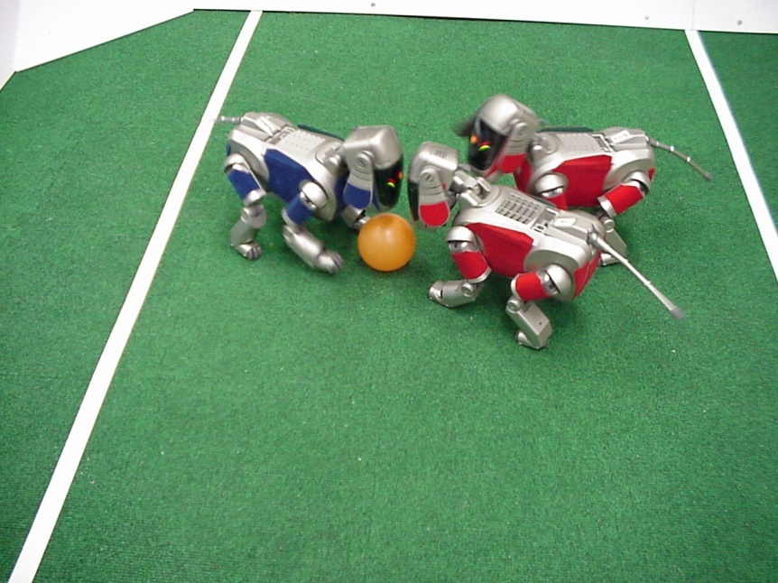
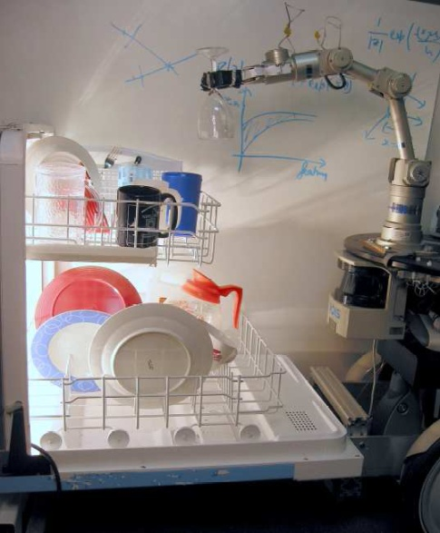
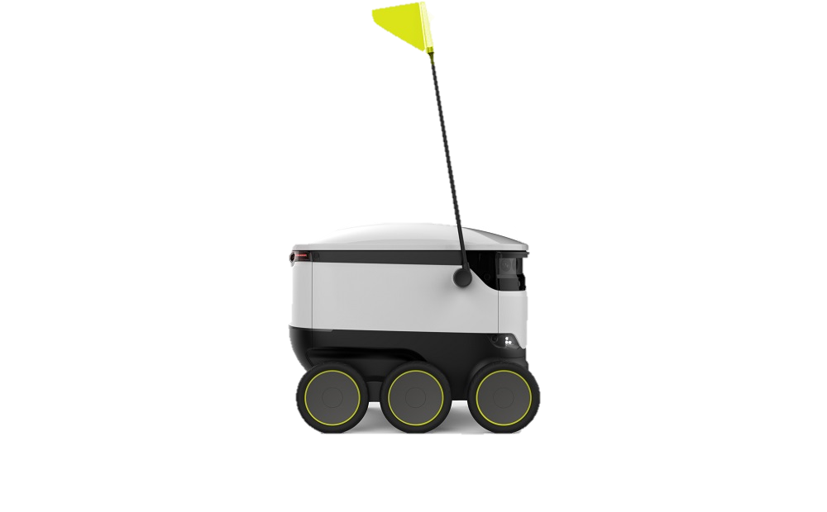
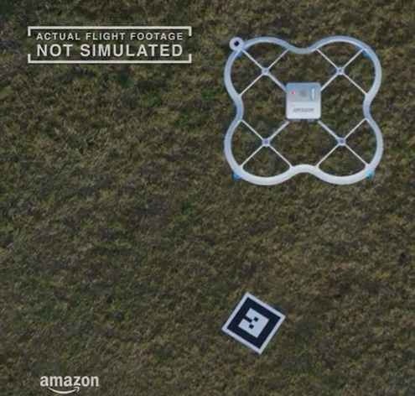
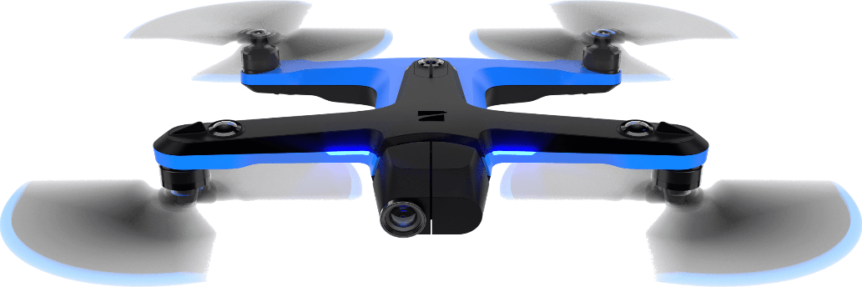


Mobile robots
http://www.robocup.org/
Saxena et al. 2008
STAIR at Stanford
Skydio 2 drone
6x fisheye cameras for obstacle avoidance
Onboard NVIDIA GPU
Notes:
DRONES!
https://www.skydio.com/

Slide 42
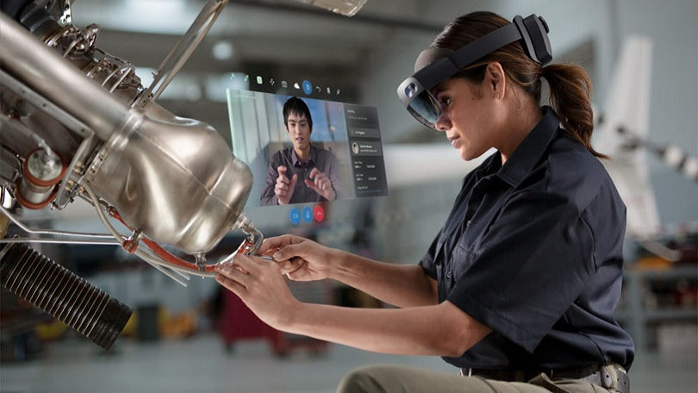
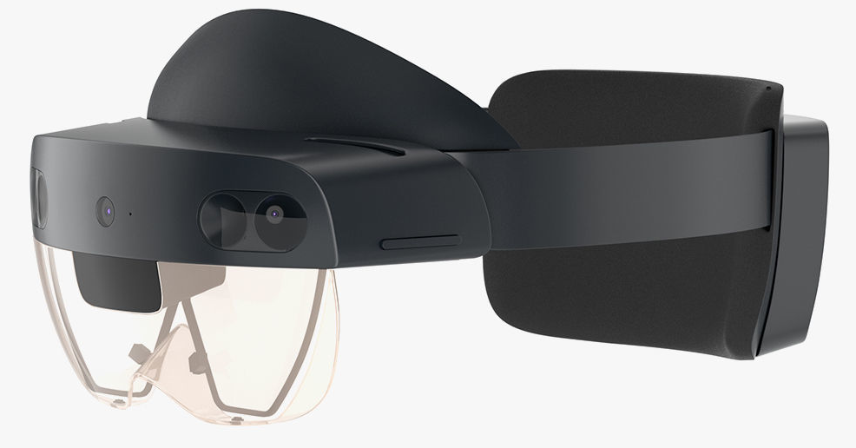
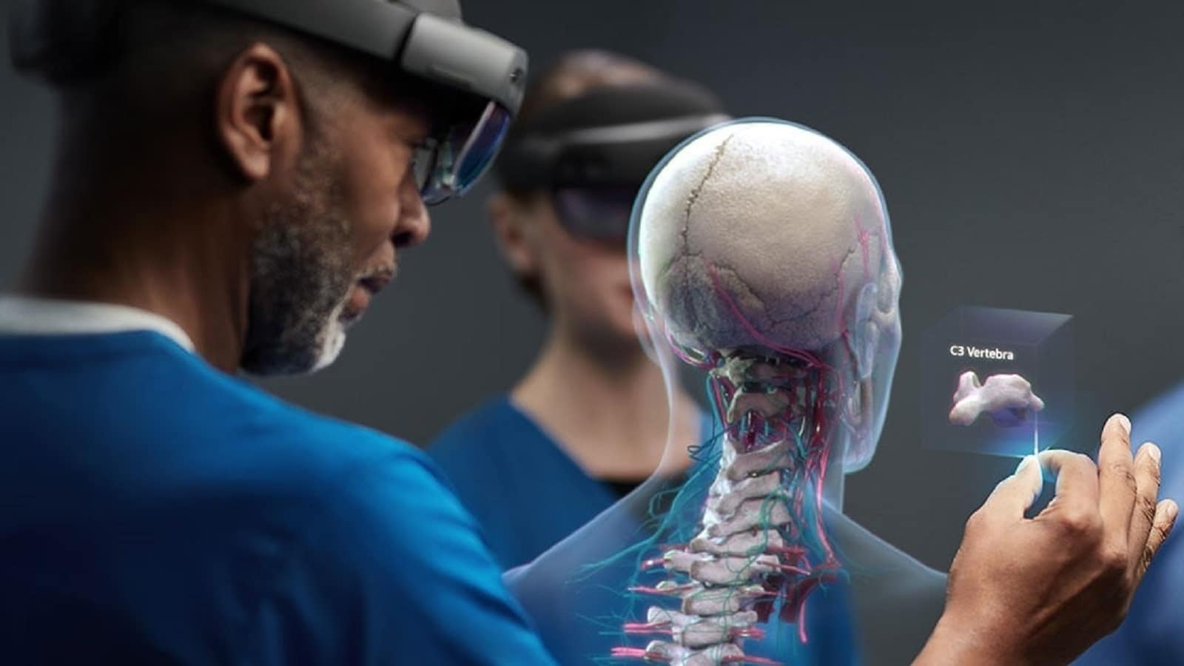
Augmented Reality and Virtual Reality
MS HoloLens, Oculus, Magic Leap,
ARCore / ARKit

Slide 43
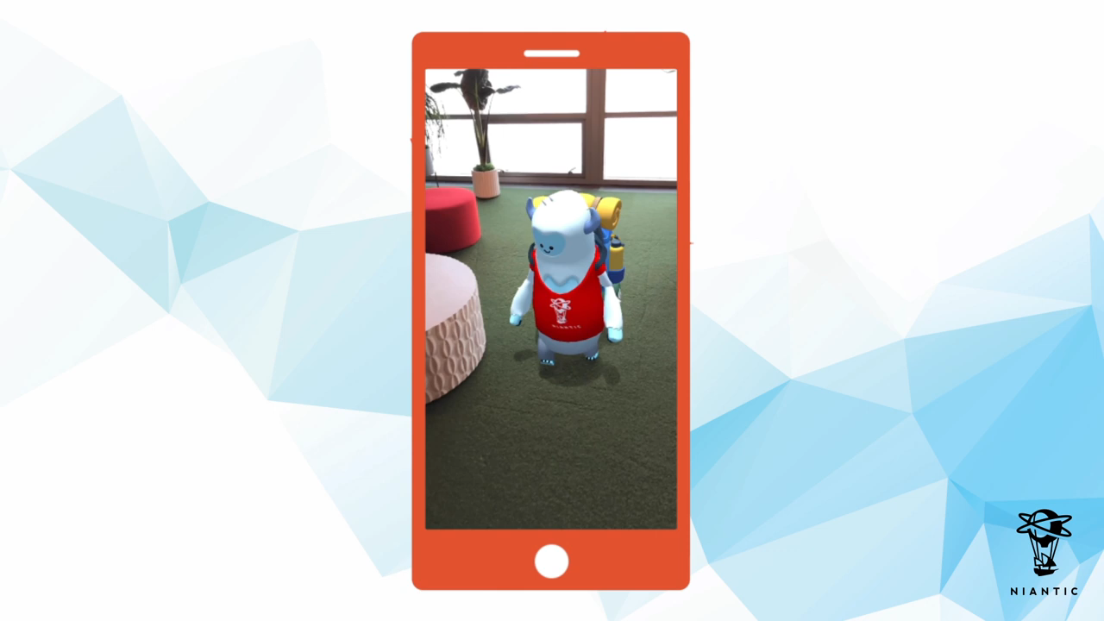

Augmented Reality and Virtual Reality
Real-time monocular depth estimation and camera tracking
Real-time 3D hand pose estimation
Oculus (Quest)
Niantic

Slide 44
Course Ethos and Scope

Slide 45
Scope of Computer Vision
Artificial Intelligence
Machine Learning
Robotics
Deep Learning
Human Computer Interaction
Image Processing
Pull from all of them!
Graphics
Neuroscience
Computational Photography
Medical Imaging
Optics
JH

Slide 46
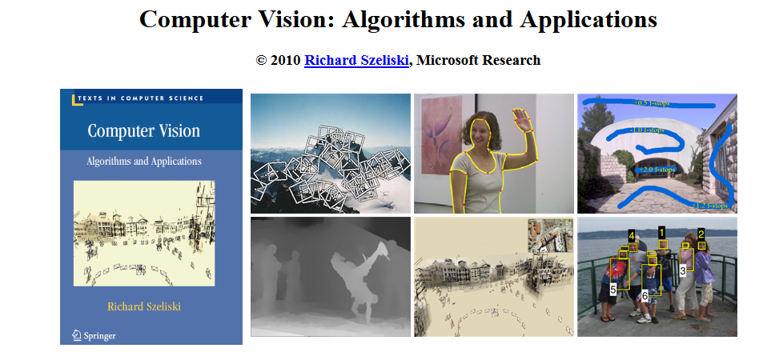
Textbooks
http://szeliski.org/Book/
JH

Slide 47

Textbooks
https://ccv.wordpress.fos.auckland.ac.nz/
Klette Concise Computer Vision
Digital copy at our library
More introductory than Szeliski.

Slide 48

Ridiculously brief history of computer vision
1966: Minsky assigns computer vision as an undergrad summer project
1960’s: interpretation of synthetic worlds
1970’s: some progress on interpreting selected images
1980’s: ANNs come and go; shift toward geometry and increased mathematical rigor
1990’s: face recognition; statistical analysis in vogue
2000’s: broader recognition; large annotated datasets available; video processing starts
2010’s: Deep learning with ConvNets
2027: My very own robot? (Konidaris)
Guzman ‘68
Ohta Kanade ‘78
Turk and Pentland ‘91
JH

Slide 49




Topics to be covered
Image processing:
Basics of filtering.
Image pyramids.
Gradients and lines.
Hough transforms.

Slide 50


Topics to be covered
Feature detection and correspondences:
Corner detection.
SIFT et al.
Feature descriptors.
RANSAC.

Slide 51

Topics to be covered
Transformations and geometry:
Homographies and image alignment.
Camera models.
Fundamental matrix.
Epipolar geometry and stereo.
Structure from motion.

Slide 52

Topics to be covered
Physics-based vision:
Reflectance and image formation.
Radiometry.
Shape from shading.
Photometric stereo.
Color.

Slide 53
Topics to be covered
Objects, faces, and learning:
Basics of probability.
K-means, KNN, PCA, SVM.
Bag of words.
Viola-Jones face detection.
Perceptron, backpropagation.
Convolutional neural networks.

Slide 54
Topics to be covered
Dealing with motion:
Optical flow (LK, HS).
Image registration.
Kalman Filtering.
Tracking (KLT, Mean-Shift).

